Slide 1
Neural Networks
Instructor: Dr. Abdul Basit
Lecture No. 1

Slide 2
Course Contents
Introduction and Review
Learning Processes
Single & Multi-layer Perceptrons
Radial Basis Function Networks
Support Vector and Committee Machines
Principle Component Analysis (PCA)
Self Organizing Maps (SOMs)
Recurrent & Temporal Feedforward Networks
Neural Networks for Optimizing Problems
Solving Matrix Algebra Problems using ANNs
Solving Linear Algebraic Equations using ANNs
Statistical Methods using ANNs
Neuro-fuzzy Computing
Neuro-genetic Computing
Neurodynamics &Dynamically Driven Recurrent Nets

Slide 3
Recommended Texts
Neural Networks: A Comprehensive Foundation by Simon Haykin, Prentice Hall, Inc., 1999.
Principles of Neurocomputing for Science and Engineering, by Fredric M. Ham and Ivica Kostanic, Tata McGraw-Hill, 2002.
Neural Networks: Algorithms, Applications & Programming Techniques by James A. Freeman and David M. Skiapura, Addison-Wesley Publishing Company, 1991.
Neural Network Toolbox: User’s Guide by Howard Demuth and Mark Beale, The Mathworks Inc., 1997

Slide 4
Evaluation and Grading
Quizzes 05
Assignments 10
Semester Project/Research Paper 15
Mid-Term Tests 15 + 15
Final Exam 40

Slide 5
Quizzes and Assignments
Quizzes
  Frequent quizzes of duration 5-10 minutes will be taken.
  Students are required to attend the classes regularly and come prepared in each class.
Assignments
  No assignments will be accepted after due date.
  Programming assignments should be well documented.
  There are “no groups” for assignments. Each student is expected to do and submit the assignment individually.
  Students are “not” allowed to “copy” each other’s work.

Slide 6
In Today's Lecture ...
Introduction
What is a Neural Network?
Mathematical Model of a Neuron
Network Architectures
Training
Commonly Used Activation Functions
Typical Problem Areas

Slide 7
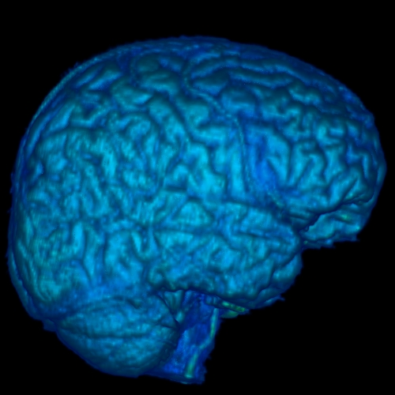
Welcome to the World of
Artificial Neural Networks
Brain
A marvelous piece of architecture and design.
In association with a nervous system, it controls the life patterns, communications, interactions, growth and development of hundreds of million of life forms.

Slide 8
Some Statistics
There are about 10¹⁰ to 10¹⁴ nerve cells (called neurons) in an adult human brain.
Neurons are highly connected with each other. Each nerve cell is connected to hundreds of thousands of other nerve cells.
Passage of information between neurons is slow (in comparison to transistors in an IC). It takes place in the form of electrochemical signals between two neurons in milliseconds.
Energy consumption per neuron is low (approximately 10⁻⁶ Watts).

Slide 9

How do the actual
neurons look like?
Look more like some
blobs of ink… aren’t they!
Taking a more closer look
reveals that there is a
large collection of different
molecules, working together
coherently, in an organized
manner.
Put together, they form the
best information processing
system in the known universe.

Slide 10
Salient Features of a Neuron
Nucleus
Axon
Synapse
Axons from
another
neurons
Cell Body
Synapse
Dendrites
Mind you, a neuron is a three dimensional entity!

Slide 11
Information Processing in a Neural Network
Flow of Information
A few Neurons and their synaptic junctions

Slide 12
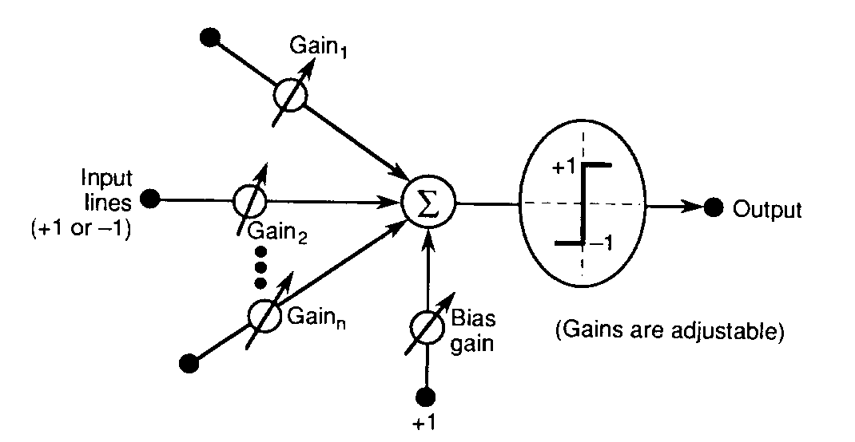
Mathematical Model of
A Typical Neuron

Slide 13
Basics of an Artificial Neural Network
An artificial neural network is an information processing system that has certain performance characteristics in common with biological neural networks.
An ANN can be characterized by:
  Architecture: The pattern of connections between different neurons.
  Training or Learning Algorithms: The method of determining weights on the connections.
  Activation Function: The nature of function used by a neuron to become activated.

Slide 14
Architecture
There are two basic categories:
Feed-forward Neural Networks
  These are the nets in which the signals flow from the input units to the output units, in a forward direction.
  They are further classified as:
    Single Layer Nets
    Multi-layer Nets
Recurrent Neural Networks
  These are the nets in which the signals can flow in both directions from the input to the output or vice versa.

Slide 15
Model 1: A Single Layer Net
w₁₁
X₁
Y₁
w₂₁
w₃₁
w₁₂
X₂
Y₂
w₂₂
l
l
l
w₃₂
l
l
l
X_{n}
w₁₃
Y_{m}
w_{2m}
w_{nm}
Input
Units
Output
Units

Slide 16

Model 2: A Multi-Layer Net
X₁
w₁₁
v₁₁
Y₁
w_{i1}
Z₁
v_{j1}
l
l
l
w_{n1}
v_{p1}
l
l
l
l
l
l
w_{1j}
v_{1k}
X_{i}
Z_{j}
Y_{k}
w_{ij}
v_{jk}
w_{nj}
l
l
l
v_{pk}
Biological
Neurons
In Action
l
l
l
l
l
l
w_{1p}
v_{1m}
Z_{p}
X_{n}
w_{ip}
v_{jm}
Y_{m}
w_{np}
v_{pm}
Input
Units
Hidden
Units
Output
Units

Slide 17
Model 3: A Recurrent Net
1
w₁₁
1
X₁
Y₁
w_{1n}
v_{1n}
v_{1m}
w_{1m}
X_{n}
Y_{m}
w_{nm}
1
1

Slide 18
Training
Supervised Training
Training is accomplished by presenting a sequence of training vectors or patterns, each with an associated target output vector.
The weights are then adjusted according to a learning algorithm.
During training, the network develops an associative memory. It can then recall a stored pattern when it is given an input vector that is sufficiently similar to a vector it has learned.
Unsupervised Training
A sequence of input vectors is provided, but no traget vectors are specified in this case.
The net modifies its weights and biases, so that the most similar input vectors are assigned to the same output unit.

Slide 19
Common Activation Functions
1. Binary Step Function
(a “threshold” or “Heaviside” function)
2. Bipolar Step Function
3. Binary Sigmoid
Function (Logistic
Sigmoid)
3. Bipolar Sigmoid
4. Hyperbolic -
Tangent

Slide 20
Typical Problem Areas
The number of application areas in which artificial neural networks are used is growing daily.
Some of the representative problem areas, where neural networks have been used are:
Pattern Completion: ANNs can be trained on a set of visual patterns represented by pixel values.
  If subsequently, a part of an individual pattern (or a noisy pattern) is presented to the network, we can allow the network’s activation to propagate through the net till it converges to the original (memorised) visual pattern.
  The network is acting like a “content- addressable” memory.

Slide 21
Typical Problem Areas
Classification: An early example of this type of network was trained to differentiate between male and female faces.
  It is actually very difficult to create an algorithm to do so yet, an ANN has shown to have near-human capacity to do so.
Optimization: It is notoriously difficult to find algorithms for solving optimization problems (e.g. TSP).
  There are several types of neural networks which have been shown to converge to ‘good-enough’ solutions i.e. solutions which may not be globally optimal but can be shown to be close to the global optimum for any given set of parameters.

Slide 22
Typical Problem Areas
Feature Detection: An early example of this is the phoneme producing feature map of Kohonen:
  The network is provided with a set of inputs and must learn to pronounce the words; in doing so, it must identify a set of features which are important in phoneme production
Data Compression: There are many ANNs which have been shown to be capable of representing input data in a compressed format loosing as little of the information as possible.
Approximation: Given examples of an input to output mapping, a neural network can be trained to approximate the mapping so that a future input will give approximately the correct answer i.e. the answer which the mapping should give.

Slide 23
Typical Problem Areas
Association: We may associate a particular input with a particular output so that given the same (or similar) input again, the net will give the same (or a similar) output again.
Prediction: This task may be stated as: given a set of previous examples from a time series, such as a set of closing prices of Karachi Stock Exchange, to predict the next (future) sample.
Control: For example to control the movement of a robot arm (or truck, or any non-linear process) to learn what inputs (actions) will have the correct outputs (results)

Slide 24
That's it for today!

