Slide 1
Course for Software Testing
BS (Software Engineering)
Spring Semester
February 2014
Foundation University Rawalpindi Campus
Instructor: Sohaib Altaf
sohaib@hybriditservices.com
http://www.hybriditservices.com/course/FU-BCSE8-ST

Slide 2
Lecture 3

Slide 3
What is quality ?
• Quality
Quality is conformance to requirements and prevention of defects.
The degree to which a system, component, or process meets specified requirements.
- The degree to which a system, component, or process meets customer or user needs
or expectations.

Slide 4
Different Views of Software Quality
Perceived in different domains differently
Views according to (Kitchenham and Pfleeger1996, Pfleeger et al., 2002, software quality:) are:
User’s | fitness for purpose
Manufacturing | conformance to specification
Product | inherent characteristics of the product
Value based | the amount a customer is willing to pay
Notes:
4
Quality Perspective from the book Wiley-InterScience - Software Quality Engineering - Testing, Quality Assurance and Quantifiable Improvement
Transcendental → Surpassing all others; Superior; Beyond common thought or experience; mystical or supernatural.
Elusive → vague, intangible, indefinable

Slide 5
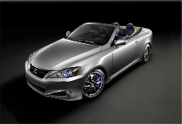
What is quality ?
Quality popular view:
  – Something “good” but not quantifiable
  – Something luxury and classy
Quality professional view:
  – Conformance to requirement
  (Crosby, 1979)
    The requirements are clearly stated and the product must conform to it
    Any deviation from the requirements is regarded as a defect
    A good quality product contains fewer defects
  – Fitness for use (Juran, 1970):
    Fit to user expectations: meet user’s needs
    A good quality product provides better user satisfaction

Slide 6
Different Views of Software Quality
User View
  The basic building block on which fitness for use is built is the Quality Characteristic.
  Any feature (property, attribute, etc.) of the products, materials, or processes
  which is needed to achieve fitness for use is a Quality Characteristic.
Manufacturing View
  The degree to which a system, component, or process meets
    Specified requirements, customer/user needs or expectations
    Conformance to process standards
Notes:
6
Quality Characteristic Example:

Slide 7
Different Views of Software Quality
Product View
  In the product view, the focus is on inherent characteristics in the product itself in the hope that controlling these internal quality indicators will result in improved external product behavior (quality in use)
Value Based View
  In the value-based view, quality is the customers’ willingness to pay for a software.
Notes:
7
Transcendental View: we can think of software quality as something towards which we strive as an ideal but may never implement completely.
Surpassing all others; Superior; Beyond common thought or experience; mystical or supernatural.

Slide 8
Software Quality Attributes
- External & Internal characteristics
Dealing with Defects in early phase or later phase? i.e. testing phase
External (Dynamic) & Internal (Static)
External (Rely on execution) Internal ( Don’t rely on execution)
correctness maintainability
reliability flexibility & reusability
usability & performance portability
completeness, consistency, usability availability of correct & complete documents
robustness structured & readability
testable
Notes:
8
Internal Metrics: Internal metrics are those which do not rely on software execution (static measures)
External Metrics: External metrics are applicable to running software.
Reliability: the capability of the system to maintain its service provision under defined conditions for defined periods of time.
Integrity is a concept of consistency of actions, values, methods, measures, principles, expectations and outcomes.
Adaptability is the ability of a system (e.g., a computer system) to adapt itself efficiently and fast to changed circumstances. An adaptive system is therefore an open system that is able to fit its behavior according to changes in its environment or in parts of the system itself.
Robustness is the quality of being able to withstand stresses, pressures, or changes in procedure or circumstance. A system, organism or design may be said to be "robust" if it is capable of coping well with variations (sometimes unpredictable variations) in its operating environment with minimal damage, alteration or loss of functionality.

Slide 9
Software Quality Attributes
Completeness refers to the availability of all features listed in the requirements, or in the user manual. An incomplete software is one that does not fully implement all features required.
Consistency refers to adherence to a common set of conventions and assumptions. For example, all buttons in the user interface might follow a common color coding convention. An example of inconsistency would be when a database application displays the date of birth of a person in the database in different formats ignoring user preference.
Difference of Term “Completeness” in Requirements and Testing Aspects?
Review all internal & external attributes from the LIST
Divide the LIST into class of attributes Internal & External?... ..…? (7th RA)

Slide 10
Software Quality Attributes
Usability refers to the ease with which an application can be used. This is an area in itself and there exist techniques for usability testing. Psychology plays an important role in the design of techniques for usability testing.
Performance refers to the time the application takes to perform a requested task. It is specified in terms such as ``This task must be performed at the rate of X units of activity in one second on a machine running at speed Y, having Z gigabytes of memory."
Review Non-functional requirements?

Slide 11
Software Quality Attributes
Portability - Will I be able to use it on another machine?
Reusability - Will I be able to reuse some of the software?
Interoperability - Will I be able to interface it with another machine?
Maintainability - Can I fix it?
Flexibility - Can I change it?
Testability - Can I test it?
Product
Revision
Product
Transition
The expected quality
Features and characteristics
of a software product
are commonly referred
to as Quality Attributes.
Product
Operations
Correctness - Does it do what I want?
Reliability - Does it do it accurately all the time?
Efficiency - Will it run on my machine as well as it can?
Integrity - Is it secure?
Usability - Can I easily use it?
Another Classification…

Slide 12
1, 2, 3 ……..…. GO!
Research Assignment in Group!
[Software Quality Attributes SQA]
Steps/Phases
Choose (2-3) types of Non-functional requirement NFR or SQA from the List or I will assign
Review these NFR or SQA in detail on basis of how these are important or critical for development of specific types or domain of software application i.e. some taxonomies of software applications
  in-house development or outsourcing
  Customize application or marketable products
  Information system or embedded system
  OO applications or SO Application
  Web or Desktop application. PC or Tablet application for Web
You will study taxonomies to determine the importance of selected NFR or SQA.
You will conclude about how testing approach, confidence on testing and its effort is different for various taxonomies on basis of your (above) selection.
Review of Non-functional requirement?

Slide 13
Quality Team
- In large organizations or projects, how to ensure that the
required level of product quality is achieved
Whose Responsibility?
- the responsibility of the so-called quality managers, quality team /
group, Test Managers, SQA, Tester etc.
- Quality group: Quality Coordinator director, manager, coordinator,
members of different department i.e. HR, PM, Finance
- Quality group at Infosys, TCS companies,
1. Can you tell the Quality group names?
2. Can you define the quality roles w.r.t. to their responsibilities so that they
can be differentiated?... ..…? (8^{h} RA)

Slide 14
Terminologies w.r.t. Software Quality
Software Quality Engineering SQE
Software Quality Assurance SQA
Software Quality Control SQC
Software Testing (SQC by Only Testing)
Total Quality Management TQM
Quality Management System QMS
Quality Improvement Process QIP
1. Can you differentiate first 5 terms
2. Differentiated between Software Testing with Software Quality?... ..…? (9^{h} RA)
Notes:
14
Transcendental View: we can think of software quality as something towards which we strive as an ideal but may never implement completely.
Surpassing all others; Superior; Beyond common thought or experience; mystical or supernatural.

Slide 15
Difference between Business Life Cycle LC, Product LC & Project LC in terms of (Project Conception, Feasibility, Concept & Development), (Realization, Acquisition, & Implementation), (Product in Service & Operations) and (Disposal & Termination)?.
What is impact of testing process in above noted processes? .. (10th RA)
Apply Quality Engineering
in Project Life Cycle?
General Engineering Practice
Quality Product s
or
Services
Quality Engineering Practice
Software Project Life Cycle
Quality Software Products
Software Engineering Practice
Requirement
Analysis & Design
Construction
Testing & Deployment
Termination (Success / Failure)
Software Development Process

Slide 16
Overall Quality Approach SDLC
Apply Ad-hoc Software Practice…conventional
Analysis
Design & Code
Test & Deploy
Apply Software Engineering Practice…..modern, thus improvement
Apply Quality Engineering Practice ….. thus improvement
New Testing Techniques
New Models, Standards
RE
Data Structure
Pre-SQA
SQA
Post SQA
Quality Management System QMS
Building Quality Process in QMS? What is impact of testing process in SQE practice….(11th RA)

Slide 17
Apply Quality in Organization
Upper Management
Finance Dept.
Payroll
Budget
Business Dept.
Marketing
SQA, SQC,
TQM
SQA, SQC, TQM
SQA, SQC,
TQM
System, IT & Software Dept.
IT Projects
Web App.
Quality Management System
Testing each unit
Building Quality Process in overall organization?
What is impact of testing process in overall organization….(12th RA)
Overall Quality in Portfolio i.e. Process, Service & Product

Slide 18
Another View
SQA, SQC, TQM
Requirement
SQA, SQC,, TQM
SQA, SQC, TQM
Test & Deploy
Design & Code
SQA, SQC,, TQM
Payroll Dept.
Quality Management System
Building Quality Process in SDLC?
QA Cycle...?, QC Cycle...?
Testing Cycle...STLC?

Slide 19
Quality Management – Supporting Processes
Project Management
Quality
Management
Managerial
Risk
Management
Processes
Planning
HR
Management
Technical
Scheduling
Configuration
Management
Context
Control
Procurement
Management
Project Management Tools
Communication & Reporting

Slide 20
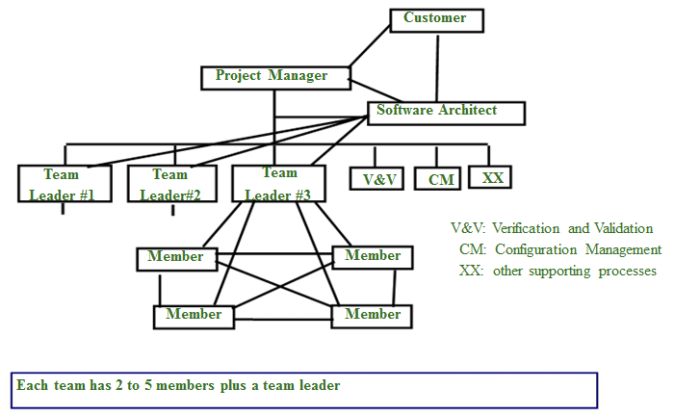
An Team Structure for Software Developments
What is difference between Quality & Testing Team? How can you fit these team in given hierarchy? …
(13th RA)

Slide 21
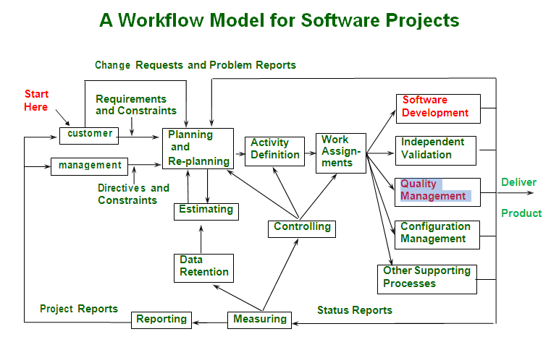

Slide 22
Overall Improvement
System
Services
Processes
People, Department, etc.
Products
Quality Management System

Slide 23
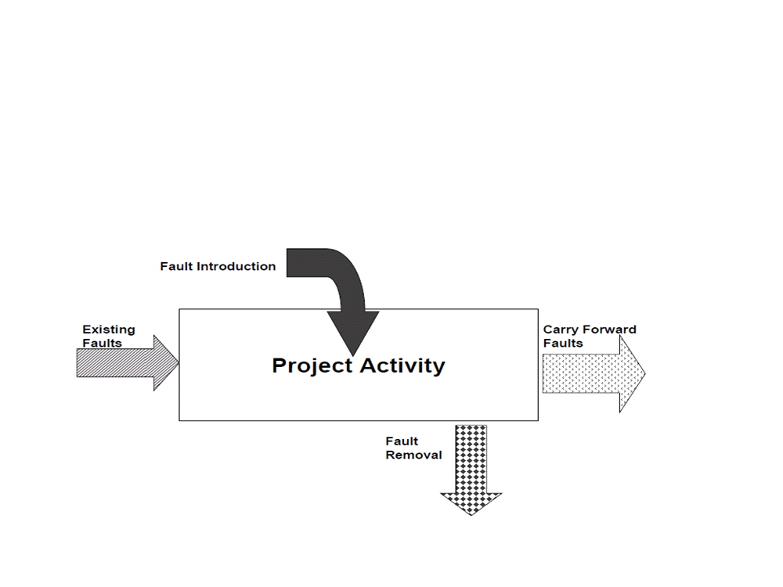
Software Quality
Software Quality Foundation
Software Lifecycle
- Defects are introduced in software by human activities through Software
Life Cycle

Slide 24
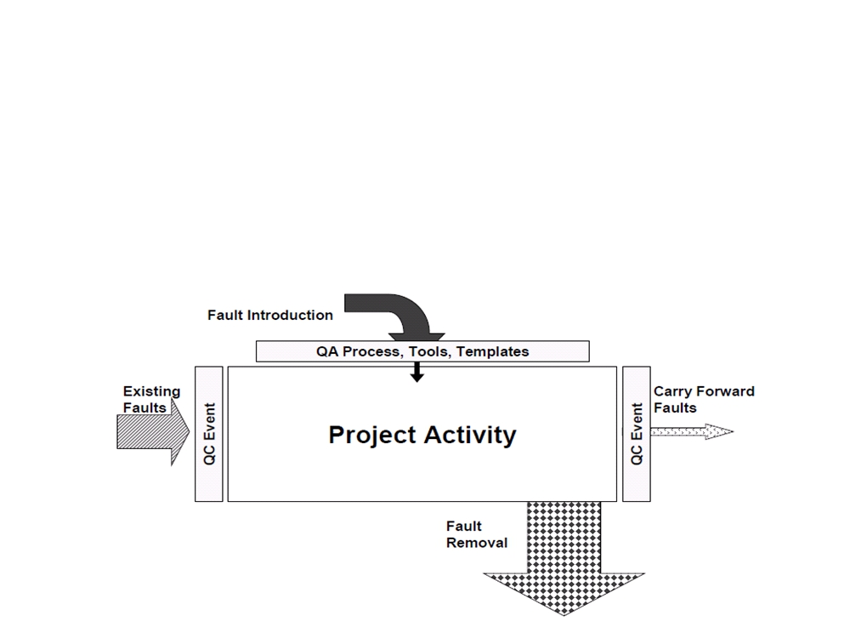
Software Quality
- Quality Assurance (QA) is fault prevention through process
design and auditing
- Creating processes, procedures, tools, jigs, etc. to prevent faults from occurring
- Examples: Templates, checklists, guides
- Main goal: prevent as much as possible defect injection

Slide 25
Software Quality
- Quality Control (QC) is fault/failure detection through static
and/or dynamic testing of artifacts
- Examining the artifact against pre-determined criteria to measure conformance
- Main goal: stop leakage of defects before deployment, find, fix, or containment

Slide 26
Difference in (QA) & (QC) ?
Quality Assurance (QA)
Things done before developing software & related produces
Develop Good Processes
Provide Good Tools
Recruit Good People Knowing the tools & processes or Train People to use Processes & Tools
Provide Adequate Supervision
Appreciate Good work
Plan for QC
What are testing activities during QA?
Quality Control (QC)
Things done after developing software & related products
In spite our best efforts, some mistakes will occur
Detect mistakes & ensures that quality standards / procedures are followed
If Testing is part of QA or QC…….(14th RA)? Software Testing Life Cycle STLC?
Difference between SDLC & STLC?

Slide 27
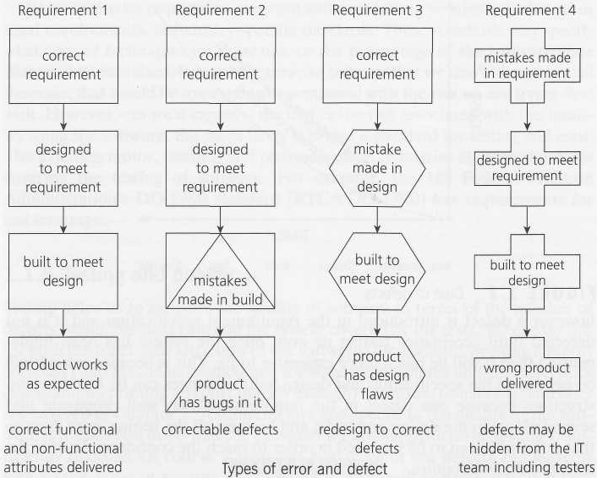
Difference in (QA) & (QC) ?
Recalling the errors …
Explain these errors &
faults both in terms of
both QA & QC (by all
approaches & by only
Testing) ..15th RA?

Slide 28
Difference in (QA) , (QC) & (Testing) ?
- Prevention process & detective process
QA –those activities which develop / modify processes to prevent introduction of defects
QC –those activities which find & correct the flaws
QA Focus ---- Process-oriented,
Randomly Evaluate the product to confirm if process works,
Ensures if process is defined & right, preventing defect from occurring
e.g. Development of methodologies & standards, Audit: Review if requirement
being defined at proper level of detail?
QC Focus ---- Products-oriented ,
Continuous activity & observe if defective,
Focus on finding, detecting & correcting the defects in specific deliverables
e.g. Are defined requirements the right requirements?
Testing ----- The process of executing a system with the intent of finding defects
Note: Prior to Process of executing a system: test planning prior to the execution of the test cases
-Testing is one most important approach of QC activity, Others are informal reviews, technical
reviews, walkthrough, inspections etc..

Slide 29
What is Software Testing?
- Like many physical system, purpose of software testing is to
ensure that software system should work as expected
- Most natural way is to show this fulfillment of expectation is to
demonstrate their operations through dry run or Controlled
experimentation in Lab Setting before they release or delivered
- In Case of software products, the controlled experimentation
through program execution is called software testing
Demonstration of proper behavior is primary purpose of testing
Detect & fix problems
Software Development Process
Our program

Slide 30
What is Software Testing?
Several definitions:
“Testing is the process of establishing confidence that a program or system does what it is supposed to.” by Hetzel 1973
“Testing is the process of executing a program or system with the intent of finding errors.” by Myers 1979
“Testing is any activity aimed at evaluating an attribute or capability of a program or system and determining that it meets its required results.” by Hetzel 1983
Software Development Process
Our program

Slide 31
What is Software Testing?
One of very important software development phases
- A software process based on well-defined software quality control and testing standards, testing methods, strategy, test criteria, and tools.
- Engineers perform all types of software testing activities to perform a software test process.
- The limitation of this approach, however, is that by the time testing occurs, it is too late to build quality into the product
- The last quality checking point for software on its production line: WARNS!
Can you explain testing process in context of QA, & QC?... ..…? (15^{h} RA)
Software Development Process
Our program

Slide 32
What is Software Testing?
One of the practical methods commonly used to detect the presence of errors (failures) in a computer program is to test it for a set of inputs. Testing detects errors; only exhaustive testing, usually infeasible, can prove correctness (absence of errors).
I1, I2, I3, …, In, …
Our program
The output
is correct?
Expected results
= ?
Obtained results
“Inputs”

Slide 33
What is Software Testing?
Another definition
“Software testing is an investigation conducted to provide stakeholders with information about the quality of the product or service under test.
Software testing also provides an objective, independent view of the software to allow the business to appreciate and understand the risks at implementation of the software.
Test techniques include, but are not limited to, the process of executing a program or application with the intent of finding software bugs. ”
Software Development Process
Our program

Slide 34
Importance of Software Testing
Prove usability and operability
To improve Quality
For reliability estimation
Know where your problem is
Prevent defect migration

Slide 35
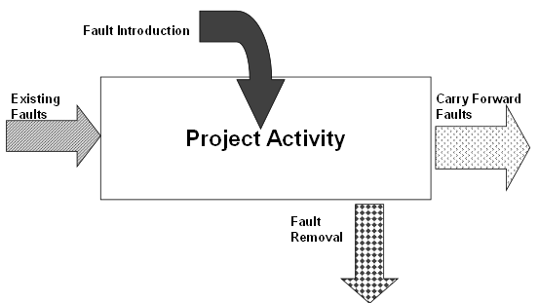
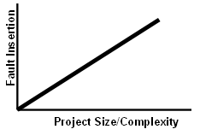
Economy: Failures Cost?
Saving the Cost
Inserting faults is the norm
High reliance on human
communication, Lack of Training
High complexity, Missing Docs
Ignorance of standard, missing reviews, insufficient testing etc. ,
*As the amount of effort increases, the number of faults will increase
How can we achieve economy in testing phase…(16th RA)?

Slide 36
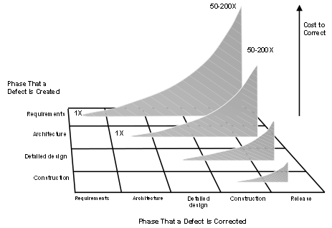
Quality Philosophy?
Quality improvement
cost increases as
we progress in the
software lifecycle ( < = 1 x)
Cost for Fixing of Defects
increases as we progress
in the software
lifecycle (= > [1 x – 200 x])
Difference of ratio? Or by x factor?
That mistakes will be made throughout the project:
Project success depends on positioning the project team to detect mistakes early so that they can correct them quickly and easily, Don’t accumulate defects for testing process (Quality Control)
2. That the way things are built greatly impacts how well they can be built:
Project success depends also on using effective and efficient methods by the
project team, Avoid defects injecting in project (Quality Assurance)

Slide 37
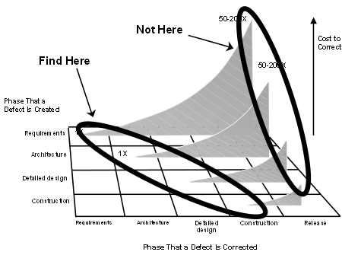
Prevention , Detection & Failures & Cost ?
Prevention
- Quality planning
- Formal process audits
- Training
Detection
- In-process and inter- process review
- Test products, phases……
- Reviews, Testing, etc….
Failure Costs
- Rework
- Repair
- Scrap
- Failure mode analysis
Complaint
resolution
Product return
and replacement
- Help line support Quality Improvement Cost is [ < = 1 x ]
- Warranty work Cost of fixing defect in later phases is [ = > 50 x – 200 ]

Slide 38
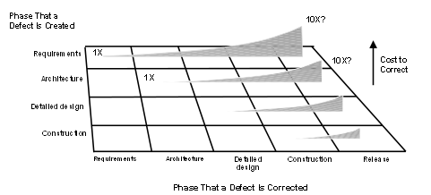
Prevention , Detection & Failures, Cost?
Prevention
- Culture
- Professional development
- Practice toolbox selection
- Checklists & Templates
- Audits
- Quality gates
- Team structure
- Continuous process improvement
Detection
- To get to acceptable defect removal rates requires a combination of techniques?
Unit testing, component testing, and system testing cannot remove full defects
Neither effective or efficient!
- Skipping reviews and/or inspections will result in high tail-end costs ! Testing Cost?

Slide 39
Cost Categorization
Prevention
- Correct Customer Requirements
Adequate Education i.e. on Testing
Process Designing i.e. of Testing
- Right Selection of People & Skill
i.e. for Testing
Detection
Reviews
Testing
Incoming Inspection, Failure Analysis
Non-conformance
Rework i.e. all phases of SDLC i.e. code & testing etc.
Additional Inventory
Additional Support calls COST of correction increases exponentially as time
Contractual Penalties between occurrence of error & detection error increases
Overtime Cost
Lost Business

Slide 40

Quality Practices in the Software Lifecycle
SQE: Pre-QA? QA (QC), Post-QA (QC)?
Pre-QA: Quality Plan
  i.e. how much testing, techniques, software application type
Prevention - Quality Assurance (QA)
  fault prevention through process design and auditing i.e. how much testing?
Detection - Quality Control (QC)
  QC Plan? fault detection through review & testing of artifacts & program
  Testing Plan?
- Post - QA (QC)
  - Measuring?
  - how much testing errors?
  - why many testing errors?
  - what violated? Standards? Team Skills?
  or Tool issue, Missing Plan?

Slide 41
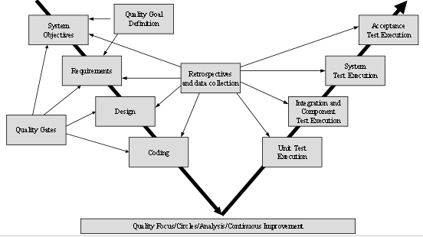
Quality Practices in the Software Lifecycle
Quality Plan?
Asses QA Process?
Implement QA Process?
QA practices

Slide 42
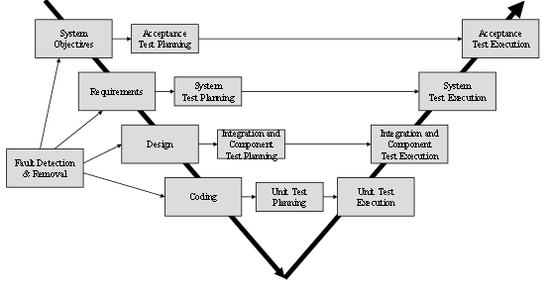
Quality Practices in the Software Lifecycle
Quality Plan?
Asses QA Process?
Implement QA Process?
QC practices

Slide 43
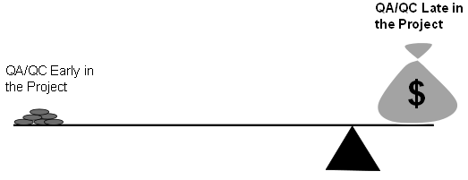
Quality Practices in the Software Lifecycle
Quality Plan?
Quality Assessment?
QA practices
QC practices

Slide 44
Quality Plan
A Quality Plan is different than a Test Plan?
A quality plan is a document setting out the specific quality practices, resources and
activities, relevant to particular product, process, service, contract or project.
Defines the Quality Goals
Realistic about where defects come from, Use Historic information for Defects Gaps
Selects appropriate prevention & detection methods
Set out the desired product qualities, and define how these are to be assessed ?
Select those organizational standards that are appropriate to a particular
process and development process.
Test Plan?
How to perform testing, design test cases, selection of techniques? When to stop?
Review Plan, Other Plans……

Slide 45
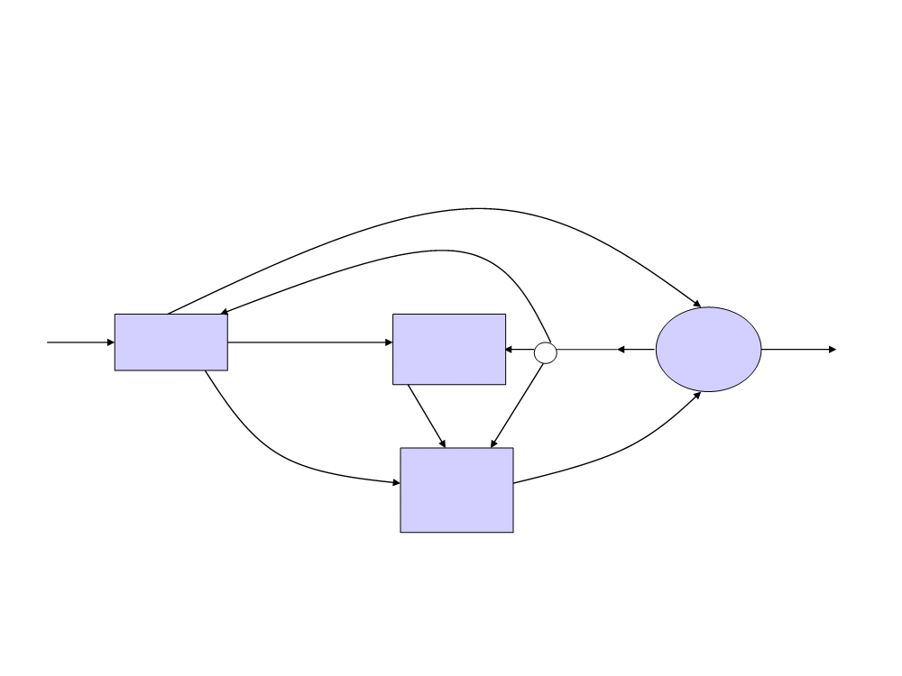
Software Quality Engineering
-Iterative process which combines quality planning, quality assurance,
and control activities.
Set quality goals
Entry
Quality
No
Quality
goals
Exit
Quality
Assurance
Activities
Planning
Selected QA
activities
Yes
satisfied?
Feedback &
adjustments
Measurements
Selected measurements
& models
Quality
Control
Activities
Analysis/
Modeling
results
-Main goal: defect prevention, defect reduction, and defect containment

Slide 46
Quality Management, Overall Improvement
- How to Achieve Quality?
CULTURE?
Define Requirements, Provide Standards, Educate, Verify Outcome, Encourage, Testing Costs
money, budget of QA, level of quality, different departments, hire & assign staff, right staff,
ensure quality, evaluation of quality process....,
How to implement quality process in overall organization? many decisions? Who INITIATE
What?
- Now what is function of Quality Management System?
- Implements of quality approaches in all aspects of organizational operations.
Think for whole System – group of elements (interrelated) organize with a purpose
  Departments
  Operations, Projects, Processes
  Taking Necessary Action to accomplish Quality
  Finally Deliver Quality Services & Projects

Slide 47
Quality Management, Overall Improvement
Now what is function of Quality Management System?
Involvement of all
  Benefit to people - every one speaks about quality, CULTURE
- Establishing Policies, Purpose, Objectives, Processes &
  Policy: high level quality reporting
Quality Approaches - Measurement of Quality
  Implement them by SQC, SQA, or SQE or not only SQC (only Testing)
  or including Testing only or Review with Testing.
  or if using Statistical SQA also
Recall…1. Can you differentiate first 5 terms
2. Differentiated between Software Testing with Software Quality?... ..…? (9^{h} RA)

Slide 48
Quality Management, Overall Improvement
Now what is function of Quality Management System?
Manage Organization Concerns for Resources etc
  Allocation of resources, Budget & Costing i.e. cost on training, various payouts
  Process Approach: People over processes (Agile), processes over people
QM is Organizational Process,
  All other efforts in the organization for continuous improvement
    SW quality being a coequal with all other efforts in the organization
  Better customer – better satisfaction
  Better supplier relationship enhance value to each other
  optimization of benefit – lead to long term benefit
  Info Sys. (Global Customer Service) – Level 5 (CMMI)

