Slide 1
Artificial Neural Network
Lecture # 8
Dr. Abdul Basit Siddiqui

Slide 2
Covered so for (Revision)
1943 McCulloch and Pitts proposed the McCulloch-Pitts neuron model.
1949 Hebb published his book The Organization of Behavior, in which the Hebbian learning rule was proposed.
1958 Rosenblatt introduced the simple single layer networks now called Perceptrons.
1969 Minsky and Papert’s book Perceptrons demonstrated the limitation of single layer perceptrons, and almost the whole field went into hibernation.
1982 Hopfield published a series of papers on Hopfield networks.

Slide 3
Covered so for (Revision)
1982 Kohonen developed the Self-Organising Maps that now bear his name
1986 The Back-Propagation learning algorithm for Multi-Layer Perceptrons was rediscovered and the whole field took off again.
1990s The sub-field of Radial Basis Function Networks was developed.
2000s The power of Ensembles of Neural Networks and Support Vector Machiness becomes apparent.

Slide 4
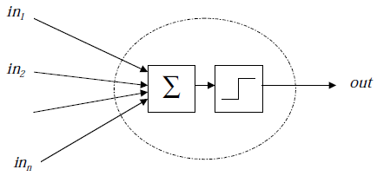
Covered so for (Revision)
Introduction to Biological Neurons and its components
The McCullock-Pitts Neurons
  Vastly simplified model of real neurons (Threshold Logic Unit)

Slide 5
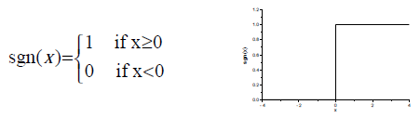
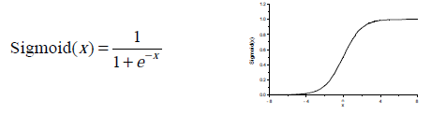
Covered so for (Revision)
Activation functions
  Step Function (Threshold or sign function)
  Sigmoid Function

Slide 6


Covered so for (Revision)
McCulloch-Pitts Neuron Equation in terms of input and output can be written as:
  Θ is threshold used to squash neuron’s output

Slide 7
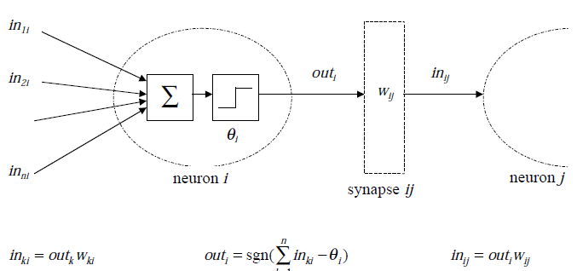
Networks of McCulloch-Pitts Neuron
We may have many neurons labeled by indices k, i, j and activation flows between them via synapses with strengths w_{ki} , w_{ij} :

Slide 8
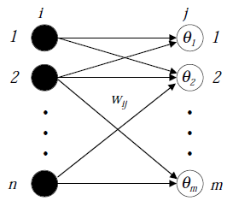

The Perceptron
Any number of McCulloch-Pitts neurons can be connected together in any way.
An arrangement of one input layer of McCulloch-Pitts neurons feeding forward to one output layer of McCulloch-Pitts neurons is known as a Perceptron.

Slide 9
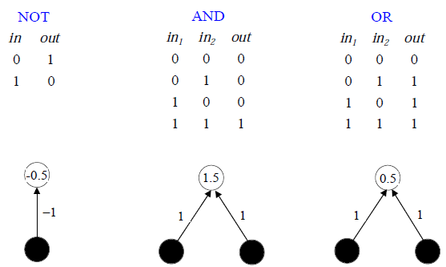
Implementing Logic Gates using McCulloch-Pitts Neurons
Logical operators AND, OR and NOT can be implemented using MP neurons. We can easily find it with inception.

Slide 10
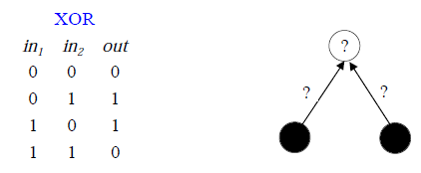
Need to find Weights Analytically
XOR function
Required to calculate the suitable parameters instead of finding solution by trial and error.
It is required to calculate the weights and thresholds.

Slide 11
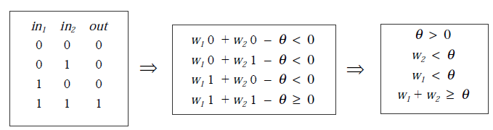
Finding Weights Analytical for the AND Network
We have two weights w₁ and w₂ and the threshold Θ, and for each training pattern we need to satisfy
  We have four inequalities
  There are infinite number of solutions for AND, OR and NOT networks.

Slide 12
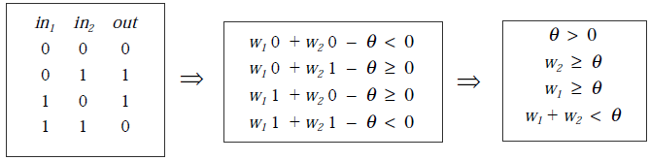
Perceptron’s Limitations
XOR function
  What is problem??
    We need more complex networks
    Or we need different activation/threshold/transfer functions
    We need to learn parameters

Slide 13
Structures of ANN
ANN is a weighted directed graph considering the activation flowing between the processing units through one way connections.
Three types of ANNs
  Single-Layer Feed-forward NNs
    One input layer, one output layer with no feedback connections (a simple perceptron)
  Multi-Layer Feed-forward NNs
    One input layer, one output layer, one or more hidden layers with no feedback connections (A multilayer perceptron)
  Recurrent NNs
    The network has atleast one feedback connection. May or may not have hidden units (A simple Recurrent Network)

Slide 14
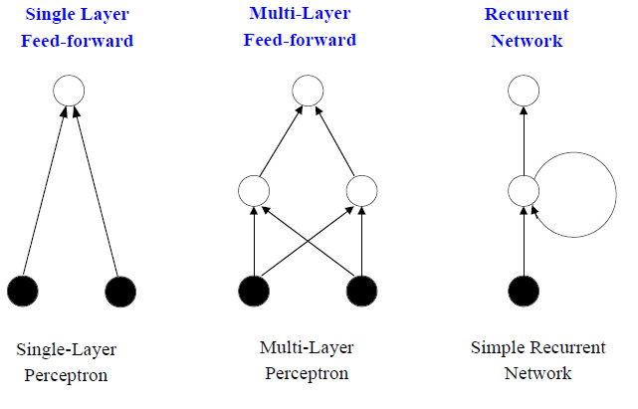
Network’s Structures Examples

Slide 15
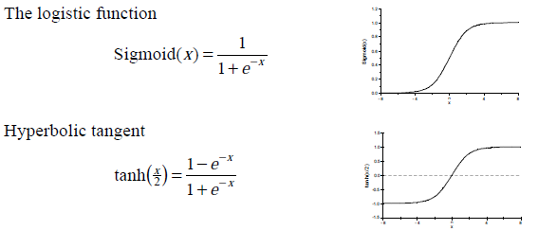
More Activation Functions
Sigmoid Functions
  These are smooth (differentiable) and monotonically increasing.

Slide 16



Bias- A special kind of Weight (Instead of Θ)
To simplify mathematics, consider threshold as a weight such that
Suppose then
Hence the equation of perceptron is simplified as

Slide 17
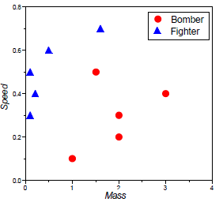
Problems with Perceptron
How to classify the data points using perceptron:
Without calculating large no. of inequalities, we have to find weights and thresholds.

Slide 18
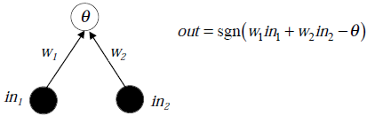

Decision Boundaries in Two Dimensions
For simple problems, our perceptron is forming decision boundaries between the classes.
  The decision boundary
  (between out = 0 and out = 1)
  is at
          w₁in₁ + w₂in₂ - Θ = 0
    Along the line
    In two dimensions, the boundaries are always straight lines.

